Slide 1




PSBs Hackathon Series 2026
(An Initiative of Government of India, Ministry of Finance , Department of Financial Services)
PRESENTS

Slide 2

PROBLEM STATEMENT & TEAM DETAILS
TEAM NAME (AS SUBMITTED ON PORTAL) |  | AuraX
PROBLEM STATEMENT TITLE |  | Using Generative AI For Attack Prediction and Remediation
 | NAME | GENDER | AREA OF EXPERTISE
Member 1 | Amina Zera Rahees | Female | Artificial Intelligence
Member 2 | Anujaya Bijay | Female | Computer Networks
Member 3 | Nandana D Nair | Female | Software Development
Member 4 | Pranitha Pramod | Female | Cybersecurity

Slide 3
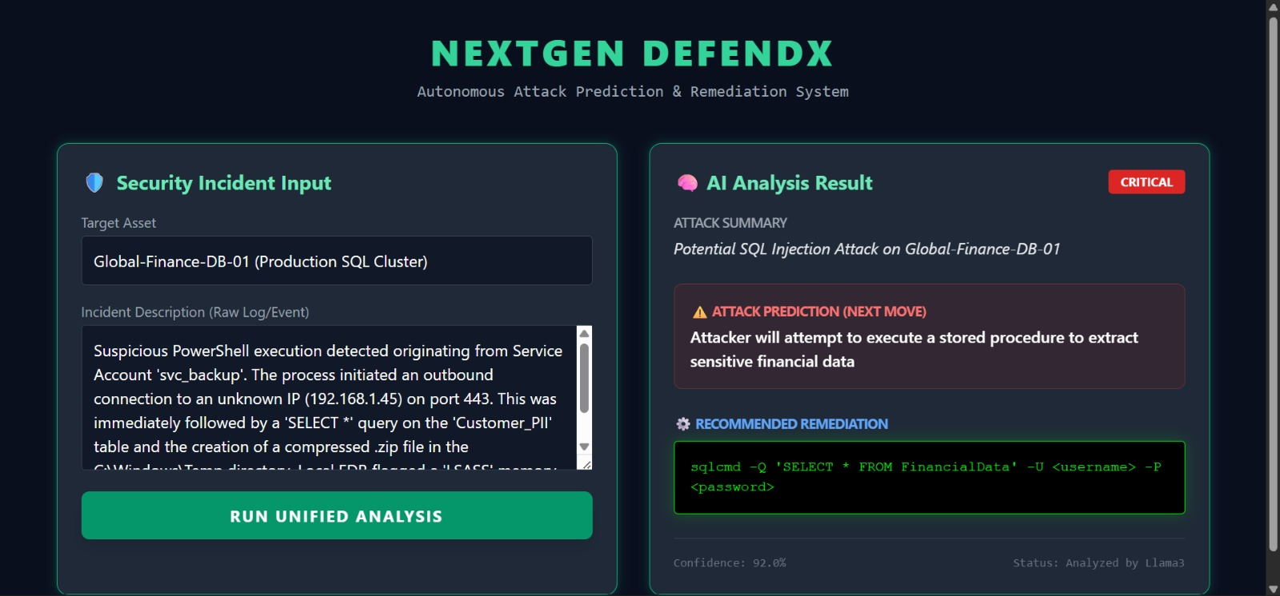
NEXTGEN DEFENDX
NextGen DefendX is an AI-driven cybersecurity platform that detects and responds to cyber threats in real time.
It utilizes STRIDE threat modelling, MITRE ATT&CK mapping,
and CVE intelligence to provide actionable insights.
Consolidating multiple events into a unified
attack narrative reduces manual investigation
and speeds up decision-making.
. The platform also employs Generative AI to predict
incidents, enhance threat detection , and automate
response recommendations, enabling faster and
more efficient threat management.
Prototype Output: Real-time AI-based threat detection, attack prediction,
and automated remediation (NextGen DefendX)

Slide 4
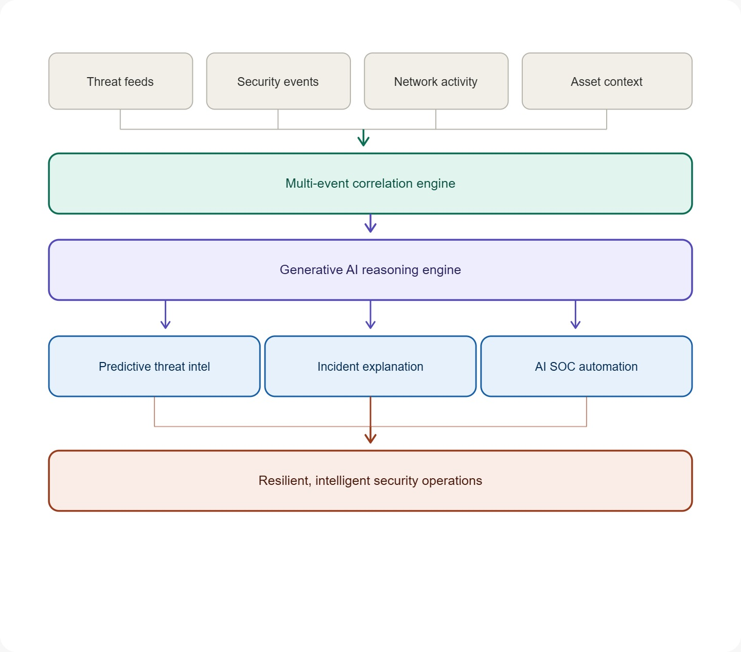
OUTLINE OF UNIQUE & INNOVATIVE SOLUTION
Generative AI as a Reasoning Engine
Generative AI provides quick insights into attack contexts, clear explanations of incidents, and informed decisions on responses.
Multi-Event Correlation into Attack Story
Rather than treating alerts individually, the system correlates multiple events over time to create a comprehensive attack narrative.
Predictive Threat Intelligence
The platform integrates STRIDE, MITRE ATT&CK, and CVE intelligence for predictive threat analysis, helping analysts make informed decisions.
AI-Driven SOC Automation
An AI SOC Analyst automates incident analysis, assigns risk scores, and suggests remediation actions.

Slide 5
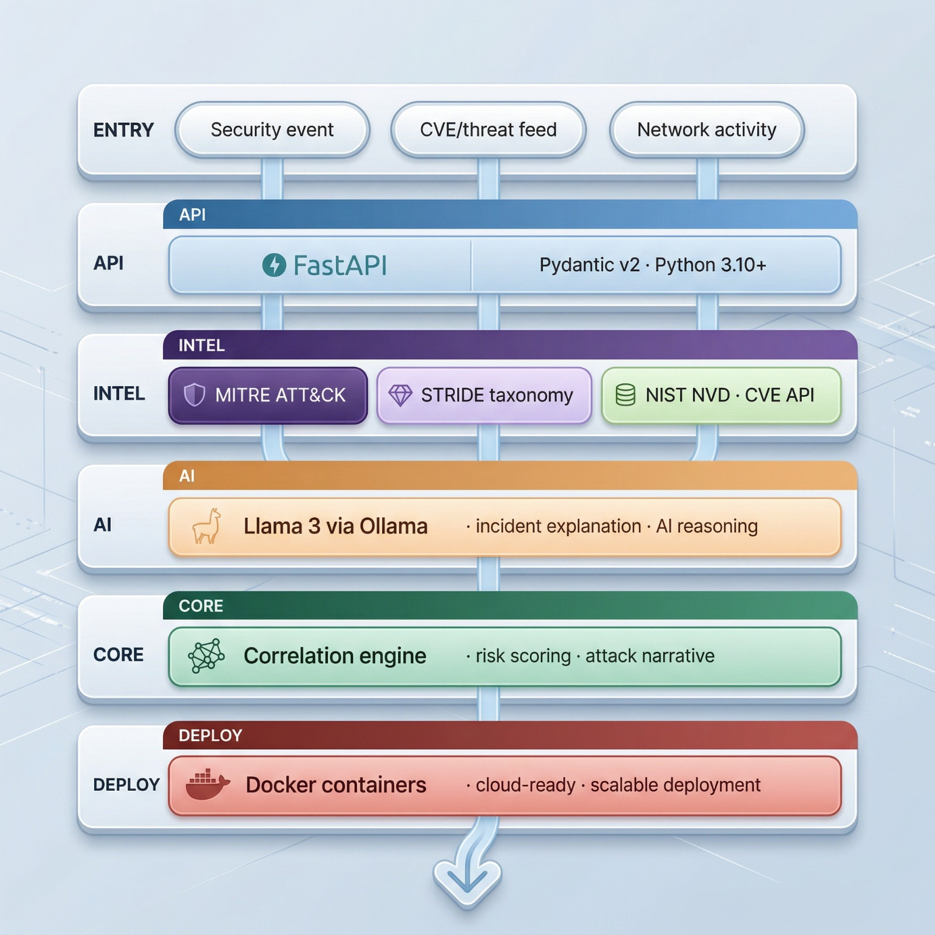
TECHNICAL APPROACH
Security Event: Captures authentication logs, API activity, and system events; serves as the primary input for threat detection.
CVE / Threat Feed Integrates real-world vulnerability data (CVE). Provides severity and threat intelligence context.
Network Activity
Helps detect anomalies and suspicious patterns. FastAPI
Handles API requests and data processing.
MITRE ATT&CK Maps detected events to real-world attack techniques. STRIDE Taxonomy Classifies threats into structured categories.
NIST NVD (CVE API)Fetches up-to-date vulnerability data. Enhances risk assessment accuracy. Llama 3 via Ollama Performs AI reasoning and attack analysis. It generates attack explanations and recommendations
Correlation Engine Performs risk scoring and threat prioritisation. Docker Containers Enables scalable and cloud-ready deployment, ensures easy setup and system portability

Slide 6








FEASIBILITY & VIABILITY
Market Viability
  Growing cybersecurity demand
  Industry investment in threat platforms
  Need for intelligent security systems
Technology Stack
Python & FastAPI - widely adopted, proven frameworks with extensive community support and documentation
AI-Powered Analysis
Llama3 via Ollama - enhanced threat reasoning,
automated operations, and intelligent security analysis
Practical Viability
  AI-accelerated response & detection
  Reduces analyst burden significantly
  Enables better security decision-making
Security Frameworks
STRIDE & MITRE ATT&CK - industry-standard methodologies ensuring reliable and comprehensive security implementation
Scalability Viability
  Cross-system & cloud expansion ready
  Handles big data processing efficiently
  Future-proof architecture design
Easy Integration
Minimal infrastructure changes
seamless adoption
Cost Viability
  Strong ROI through automation
  Reduces long-term security spending

Slide 7






IMPACT & BENEFITS
Proactive Cyber Defense
Reduced Alert Fatigue
Faster Incident Response
Shift to proactive cybersecurity using Generative AI to detect and neutralize threats early.
Use event correlation and risk-based prioritization to reduce alert volume and focus on what matters.
Speed incident response using AI-driven insights and precise remediation for faster, more accurate action.
Improved Threat Prioritization
Enhanced Attack Visibility
Operational Efficiency
Gain complete visibility into attacks with comprehensive narratives, enabling analysts to understand progression, entry points, and affected assets.
Automate detection, analysis, and response to reduce manual workloads, lower costs, and maximize SOC efficiency.
Prioritize critical vulnerabilities by integrating STRIDE, MITRE ATT&CK, and CVE intelligence to target real-world threats.

Slide 8
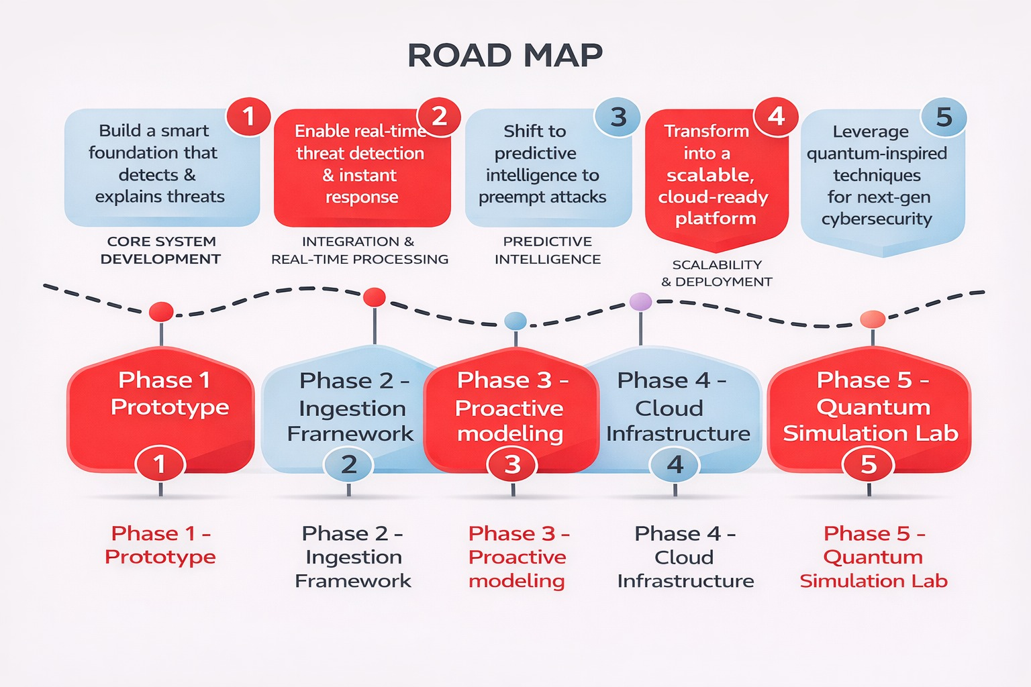
Revenue Model
Target Customers
Subscription based on usage (EPS)
Managed Security Service Providers (MSSPs)
Market Opportunity
On-premise licenses + annual maintenance
Paid add-ons (MITRE & CVE intelligence)
Mid-sized companies (200–2000 employees)
Government & defense (secure on-premise needs)
SIEM market growing to $9.5B by 2028
60% of SMBs face security incidents
Rising need for automated threat detection
Growth Potential
Expand to full XDR platform
Enter global markets (EMEA & APAC)
Partner with AWS, Azure, GCP
BUSINESS MODEL

Slide 9
RESEARCH & REFERENCES
Inc., G. (September 18, 2025). Gartner Says That in the Age of GenAI, Preemptive Capabilities, Not Detection and Response, Are the Future of Cybersecurity. Gartner. https://www.gartner.com/en/newsroom/press-releases/2025-09-18-gartner-says-that-in-the-age-of-genai-preemptive-capabilities-not-detection-and-response-are-the-future-of-cybersecurity
al., P. e., al., H. e., al., P. e., al., M. e., al., L. e., al., D. e., Khalil, al., A. e. & al., G. e. (2025). Generative AI: a double-edged sword in the cyber threat landscape. Artificial Intelligence Review. https://doi.org/10.1007/s10462-025-11285-9
Wan, S., Nikolaidis, C., Song, D., Molnar, D., Crnkovich, J., Grace, J., Bhatt, M., Chennabasappa, S., Whitman, S., Ding, S., Ionescu, V., Li, Y. & Saxe, J. (2024). CYBERSECEVAL 3: Advancing the Evaluation of Cybersecurity Risks and Capabilities in Large Language Models. arXiv preprint arXiv:2408.01605. https://doi.org/10.48550/arXiv.2408.01605
Orpak, K. (2025). Generative AI and Cybersecurity: Exploring Opportunities and Threats at Their Intersection. Maandblad voor Accountancy en Bedrijfseconomie 99(4), pp. 221-230. https://doi.org/10.5117/mab.99.149299
(2024). Incident Command: AI Powered Next-Gen SIEM. Rapid7. https://www.rapid7.com/products/insightidr/features/deception-technology/
(2023). Log Generation - an overview. ScienceDirect Topics. https://www.sciencedirect.com/topics/computer-science/log-generation
(March 24, 2026). Cybersecurity's new race: Finding the CrowdStrike or Wiz of AI security. Axios. https://www.axios.com/2026/03/24/cybersecuritys-new-race-finding-the-crowdstrike-or-wiz-of-ai-security
(n.d.). Threat Intelligence Platforms Market Size, Share &amp; 2030 Growth Trends Report. https://www.mordorintelligence.com/industry-reports/threat-intelligence-platforms-market
Simon, R. (2025). AI-Powered Threat Intelligence: Predicting Cyberattacks Before They Happen. IBM. https://www.ibm.com/new/product-blog/ai-powered-threat-intelligence-predicting-cyber-attacks-before-they-happen
Das, B. C., Sartaz, M. S., Reza, S. A., Hossain, A., Nasiruddin, M., Bishnu, K. K., Sultana, K. S., Shatyi, S. S., Khan, M. A. & Abed, J. (2025). AI-Driven Cybersecurity Threat Detection: Building Resilient Defense Systems Using Predictive Analytics. arXiv preprint. https://doi.org/10.48550/arXiv.2508.01422
Sullivan, F. &. (February 16, 2026). Modern SIEM Market to Reach $13.55 Billion by 2029, Driven by AI, Cloud-Native Platforms, and Rising Cyber Threats. PR Newswire.
https://www.prnewswire.com/news-releases/modern-siem-market-to-reach-13-55-billion-by-2029--driven-by-ai-cloud-native-platforms-and-rising-cyber-threats-302688812.html
(2024). IT Security Economics 2024. Kaspersky. https://www.kaspersky.com/blog/it-security-economics-2024/
Google drive link to our idea: https://docs.google.com/document/d/1-4L9qZv8BqVGHFtIryc64sBkpEs9NpSOIsQ7T1bQIq4/edit?usp=sharing

